Slide 1
Lecture 12: Swapping
CS343 – Operating Systems
Branden Ghena – Fall 2020
Some slides borrowed from: Stephen Tarzia (Northwestern), Shivaram Venkataraman (Wisconsin), and UC Berkeley CS162

Slide 2
Today’s Goals
Insight into how virtual memory is used and what it looks like in today’s systems.
Review of the memory hierarchy and how the OS interacts with each level.
Introduce swapping as a mechanism for enabling more virtual memory than physical memory.
Explore several page replacement policies that control swapping.

Slide 3
Outline
Paging in modern OS
Memory Hierarchy
Swapping
Page Replacement Policies

Slide 4
OS management of processes with paging
When loading a process
OS places actual memory into physical pages in RAM
OS creates page table for the process
OS decides access permissions to different pages
OS connects to shared libraries already in RAM
When a context switch occurs
OS changes which page table is in use (%CR3 register in x86)
When a fault occurs
OS decides how to handle it. (Invalid access or missing page?)

Slide 5
Page faults enable lazy allocation and lazy loading
Paging is not just translation and overflow
Paging provides an opportunity to be lazy about loading requested data
This is an important performance optimization, reducing program start time
If a process requests a huge chunk of memory, maybe it will not use all that memory immediately (or ever!).
Programmers and compilers are sometimes greedy in their requests
We can virtually allocate memory, but mark most of the pages “not present”
Let the CPU raise an exception when the memory is really used
Then really allocate the demanded page
Lazy allocation minimizes latency of fulfilling the request and it prevents OS from allocating memory that will not be used.

Slide 6
Lazy loading in practice
Lazy loading also works for large code binaries
Delay loading a page of instructions until it’s needed
OS must also write zeros to newly assigned physical frames
Program does not necessarily expect the new memory to contain zeros,
But we clear the memory for security, so that other process’ data is not leaked.
OS can keep one read-only physical page filled with zeros and just give a reference to this at first.
After the first page fault (due to writing a read-only page), allocate a real page.

Slide 7
Lazy allocation via copy-on-write with Fork
Recall that fork + exec is the only way to create a child process in unix
Fork clones the entire process, including all virtual memory
This can be very slow and inefficient, especially if the memory will just be overwritten by a call to exec.
Copy on write is a performance optimization:
Don’t copy the parent’s pages, share them
Make the child process’ page table point to the parent’s physical pages
Mark all the pages as “read only” in the PTEs (temporarily)
If parent or child writes to a shared page, a page fault exception will occur
OS handles the page fault by:
Copying parent’s page to the child & marking both copies as writeable
When the faulting process is resumed, it retries the memory write.

Slide 8
Virtual memory in practice
On Linux, the pmap command shows a process’ VM mapping.
We see:
OS tracks which file code is loaded from, so it can be lazily loaded
The main process binary and libraries are lazy loaded, not fully in memory
Libraries have read-only sections that can be shared with other processes
cat /proc/<pid>/smaps shows even more detail
References:
https://unix.stackexchange.com/a/116332
https://www.akkadia.org/drepper/dsohowto.pdf

Slide 9
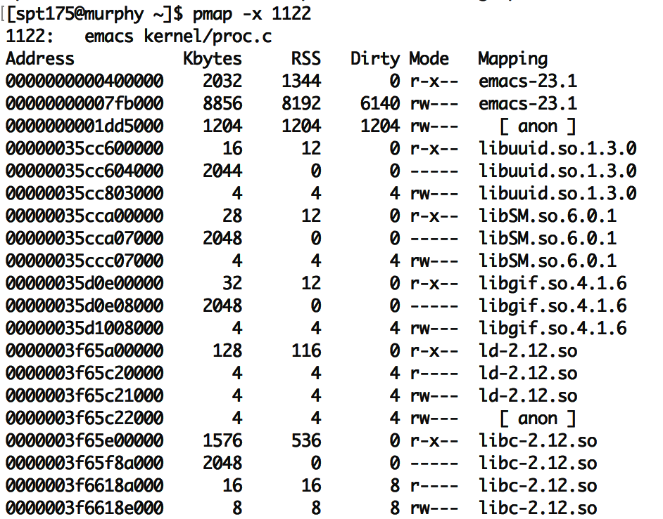
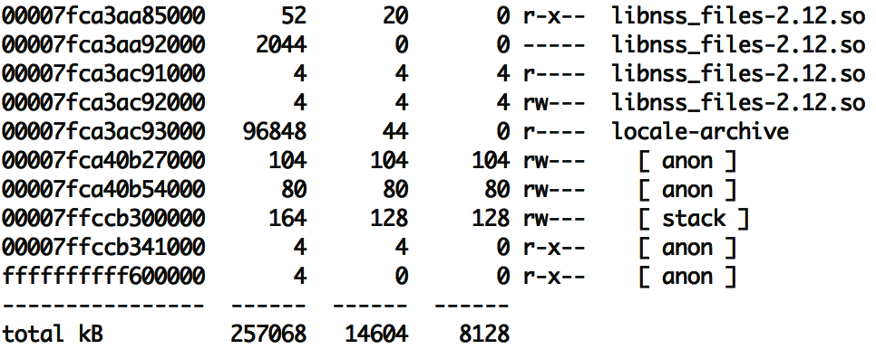
pmap on emacs
“Mapping” shows source of the section, more code can be loaded from here later.
“anon” are regular program data, requested by sbrk or mmap. (In other words, heap data.)
Each library has several sections:
“r-x--” for code can be shared
“r----” for constants
“rw---” for global data
“-----” for guard pages:
(not mapped to anything, just reserved to generate page faults)
RSS means resident in physical mem.
Dirty pages have been written and therefore cannot be shared with others
… … …

Slide 10
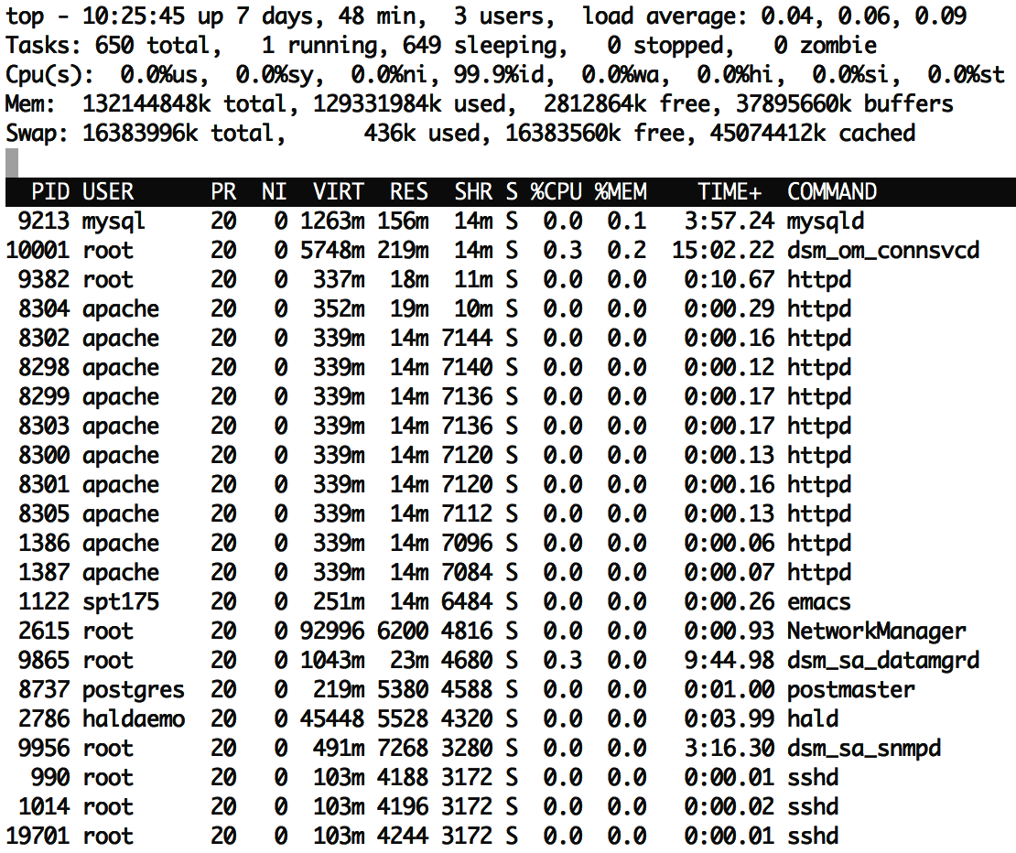
top has a column showing shared memory
The duplicate processes are using a lot of shared memory:
~50% of resident memory for httpd is shared ~75% of resident memory for sshd is shared
Even if there is just one instance of emacs running, it may share many libraries with other running programs.
Total virtual memory is ~10x larger than resident memory
Processes only use a small fraction of their VM!
Due to sharing and lazy loading.

Slide 11
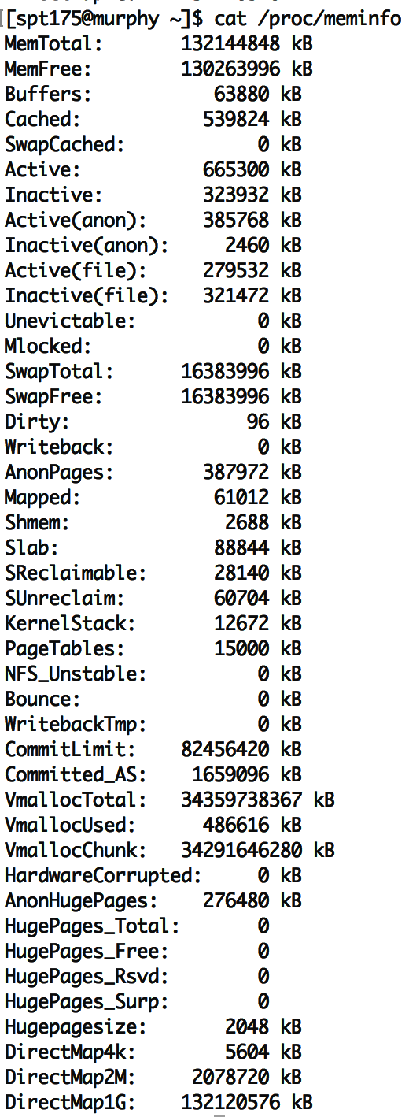
To see VM info on Linux
cat /proc/meminfo
vmstat
top
(resident)

Slide 12
Requesting memory from the OS – brk()
System call to change data segment size (the program “break”)
Either set a new virtual address pointer for top of data segment
Or increment the size of the data segment by N bytes
These are the old system calls to dynamically change program memory
How malloc creates space
“sbrk() and brk() are considered legacy even by 1997 standards”
Removed from POSIX in 2001
Still exists in some form in lots of OSes (including Nautilus)

Slide 13
Modern requesting memory from the OS – mmap()
Map (or unmap) files or devices into memory
Given a file, places the file in the process’s virtual address space
Process can request an address to place it at, which OS might follow
Given flag MAP_ANONYMOUS, creates empty memory
Initialized to zero and accessible from process
Malloc implementation uses this
Many other options
Create huge page, create memory for a stack, shared memory

Slide 14
Outline
Paging in modern OS
Memory Hierarchy
Swapping
Page Replacement Policies

Slide 15
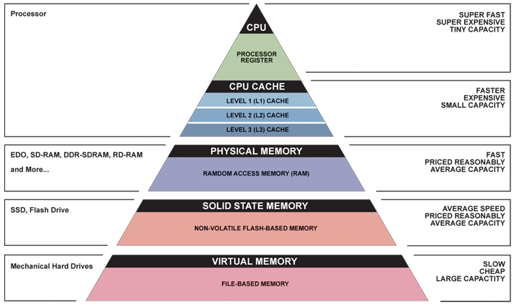
Memory Hierarchy

Slide 16
The OS view on registers
Illusion: separate set for each process
Reality: separate set for each core (or each thread in a core)
OS needs to save and update registers whenever the currently running process changes
Process and hardware handle moving memory into registers

Slide 17
The OS view on caches
Mostly ignore them, handled by the hardware automatically
Occasionally might need to clear them for security purposes
Addresses in the caches are either entirely physical addresses
Or are virtually indexed, physically tagged
Cache lookup and TLB lookup happen in parallel
TLB result is used as Tag for cache to determine if there was a hit

Slide 18
The OS view on memory
Managed through virtual memory translation
Paging (or Segmentation) that we talked about last time
OS chooses which portions of processes go in RAM
Other portions of memory get “swapped” to disk
Writeable memory regions (stack, heap, global data) must be preserved
Read-only memory regions (code) can be reloaded from original location

Slide 19
The OS view on disk
Non-volatile memory store
Everything else on the system disappears when power is removed (and cannot be trusted across reboots)
Backing store for lots of information
Boot information: via “Master Boot Record” on disk
Filesystem, which the OS manages access to through system calls
Swap space, which the OS moves extra pages in and out of
Disk is significantly bigger than RAM, so this will work
Disk is a device that the OS manages and reads in “blocks”
Compare to memory, which is directly addressed by processes

Slide 20
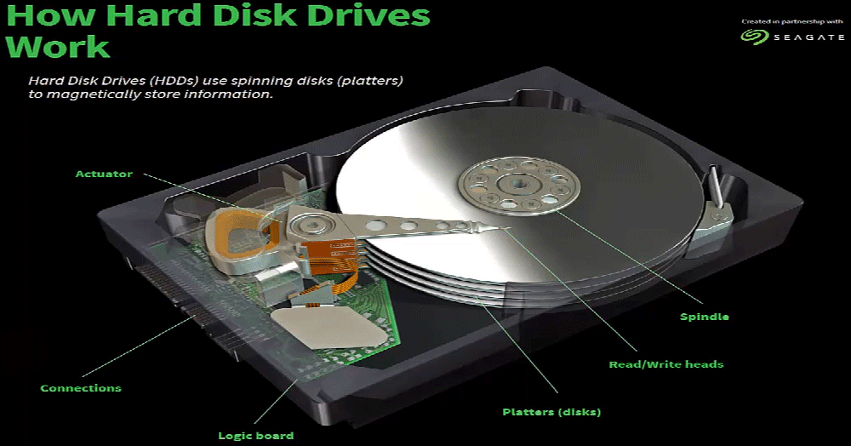
Traditional hard disk drives (HDDs) use magnetic regions

Slide 21
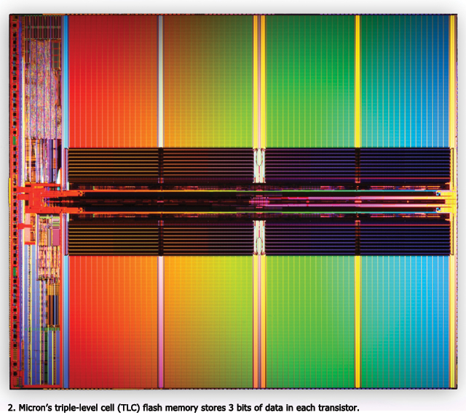
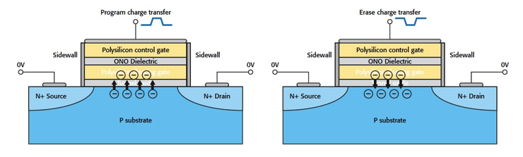
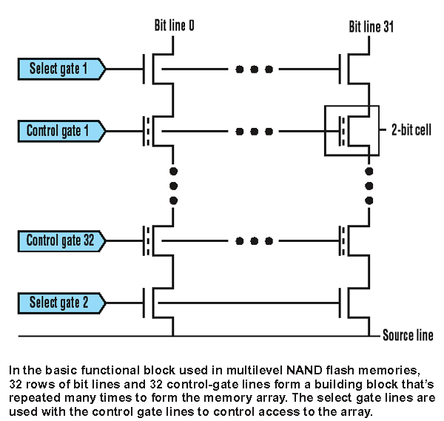
Solid state drives (SSDs) use flash memory
Still non-volatile
Significantly faster
0.1 ms to access (10 ms for disk)
More limited lifetime than disk
NMOS transistor with an additional conductor between gate and source/drain which “traps” electrons. The presence/absence is a 1 or 0

Slide 22
Outline
Paging in modern OS
Memory Hierarchy
Swapping
Page Replacement Policies

Slide 23
Motivation for swapping
Processes should be independent of the amount of physical memory
Should be correct, even if not performant
OS goal: support processes when not enough physical memory
Multiple processes combining to more than physical memory
Single process with very large address space
Video games: Red Dead Redemption 2 – 150 GB
Large-scale data processing: Compiling Android – 16 GB
OS provides illusion of more physical memory by using disk

Slide 24
Locality of reference
If disk is involved with memory, won’t this be ridiculously slow?
Leverage locality of reference within process
Spatial: memory addresses near referenced address likely to be next
Temporal: referenced addresses likely to be referenced again
Processes spend majority of time in a small portion of code
Estimate: 90% of time spent in 10% of code (loops)
Implication
Process only uses small amount of address space at any moment
Only small amount of address space needs to be in physical memory
RAM acts as a sort of cache for program memory

Slide 25
How swapping works
OS moves unreferenced pages to disk
Processes can still run when not all pages are in physical memory
OS and hardware cooperate to make memory available when needed
Same behavior as if all of address space always was in memory
Except in terms of time, but processes don’t know about time…
Requirements
OS needs mechanism to identify location of address space pages on disk and move them into RAM when necessary
OS needs policy to determine which pages go in RAM or disk

Slide 26
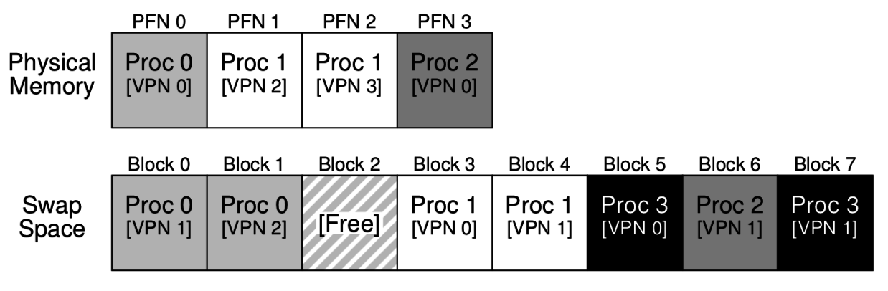
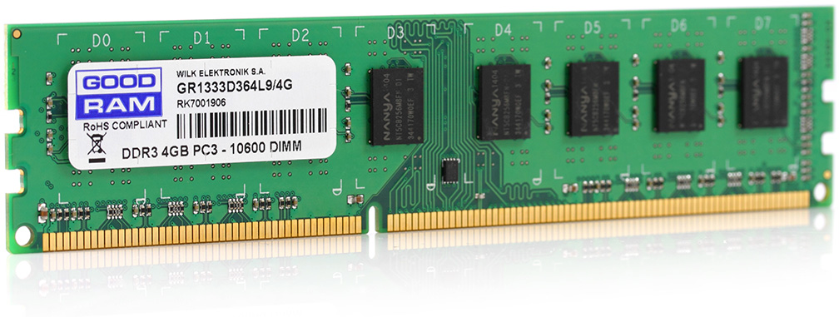
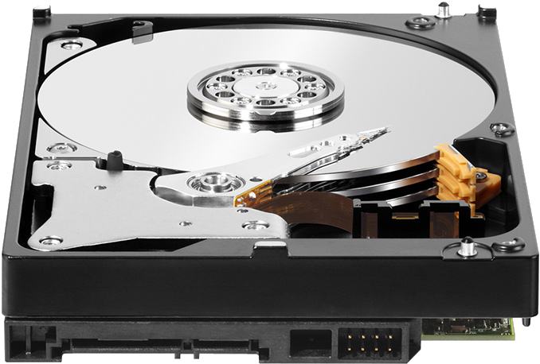
Combination of swapping and paging
Processes have memory pages, which are distributed among RAM and Disk
Example:
Processes 0, 1, and 2 are partially in RAM
Process 3 is entirely in “swap space” on disk

Slide 27
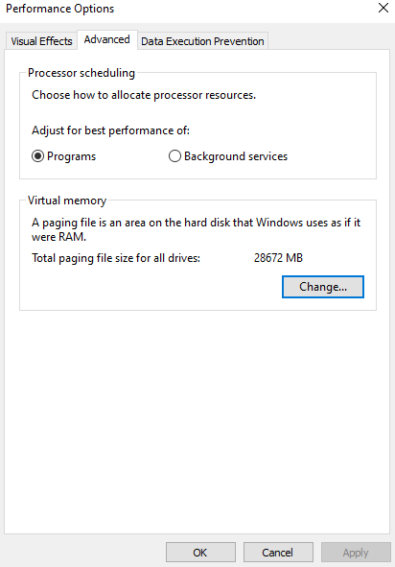
Paging on Windows
Windows lets you see and even set the size of swap space on disk

Slide 28
Mechanisms to support swapping
Each page in virtual address space lives in a location
Physical memory
Disk
Nowhere
Extend page tables with an extra bit – present
Physical Page Number, Permissions, Valid, Present
Page in memory, valid and present
Page on disk, valid but not present
Page Table Entry points to block on disk instead!
Trap to OS on reference
Invalid page, not valid not present and bad permissions
Trap to OS on reference

Slide 29
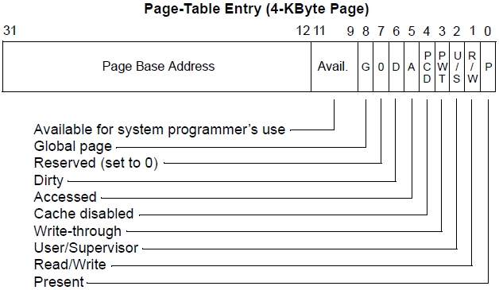
Extraneous bits in page table entry
Page Base Address can be reused to hold disk block
Dirty bit
Whether page has been modified
If page needs to be swapped out, only preserve if modified

Slide 30
Steps to a memory access with swapping
Hardware checks TLB for virtual address
If Hit, address translation complete AND page in physical memory
Hardware (or OS) walks page tables
If valid and present, then page in physical memory
Trap into OS
If invalid or bad permissions, fault process (segmentation fault)
If valid but not present
If memory is full, select a victim page in memory to replace
If modified (dirty), write to disk
Invalidate TLB entry for that page
OS reads referenced page from disk into memory
Page table is updated, present bit is set
Resume process execution (could be really complicated on CISC machines)

Slide 31
Types of page faults
Minor/soft: Page is loaded in memory, but PTE is not configured:
Memory could be a shared library already in memory from another process.
OS could be tracking accesses to this page. (hardware without a dirty bit)
Response: update the PTE.
Major/hard: A disk access will be needed:
Anonymous page (process data) may have been swapped out.
Lazy-loading program executable.
Response: load the page from disk
Invalid: User program misbehaved:
Dereference null or invalid pointer.
Write to page that is read-only.
Execute code on a page that is not executable (for security).
Response: terminate the process.

Slide 32
Policies to determine swapping evictions
Goal: minimize the number of page faults
Page faults need to read/write from disk and are very slow
So the OS can take plenty of time to make a good decision
OS has two decisions
Page Selection
When should a page be brought into memory?
Page Replacement
When should a page be swapped into disk?
Which page should be swapped out of physical memory?

Slide 33
When do we load in pages? (page selection)
Demand paging: Load page only when page fault occurs
Intuition: Wait until page must absolutely be in memory
When process starts: No pages are loaded in memory
Problems: Pay cost of page fault for every newly accessed page
Pre-paging (prefetching): Load page before referenced
OS predicts future accesses and brings pages into memory early
Works well for some access patterns (e.g., sequential)
Hints: Combine above with user-supplied hints about page references
User specifies: may need page in future, don’t need this page anymore, or sequential access pattern, ...
Example: madvise() in POSIX – “give advice about use of memory”

Slide 34
When do we swap out pages? (page replacement)
Demand swapping: whenever the page fault actually occurs
Simplest method
Swap actually occurs asynchronously
Start the disk I/O and block the process that faulted
Background swapping: preemptively when RAM is getting full
Background service in kernel periodically runs (kswapd)
If number of free physical pages < “low water mark”, evict a bunch
Writing many pages to disk in one operation is way more efficient

Slide 35
Thrashing
Thrashing: when swapping happens frequently
Policy could be bad (working set keeps getting swapped to disk)
More likely RAM is too small
Frequent swapping slows down the whole computer to a crawl
Constantly waiting on disk I/O
Solution for thrashing
Kill processes until it stops (relieves memory pressure)
Install more RAM in the computer

Slide 36
Outline
Paging in modern OS
Memory Hierarchy
Swapping
Page Replacement Policies

Slide 37
Which page should be evicted?
Page replacement policy determines page to evict
Very similar process as cache eviction or TLB eviction
Misses are expensive, so make sure you evict the right page
Page faults are extremely long, so a sophisticated policy is possible

Slide 38
Optimal page replacement policy
Optimal page replacement
Evict page that will be accessed furthest in the future
Advantages
Guaranteed to minimize the number of page faults
Disadvantages
Requires the OS to predict the future and therefore cannot exist
Performance upper bound
This is the best anything can do, so it is useful to compare against
Still has misses due to cold-start and capacity

Slide 39
First-In-First-Out replacement policy
FIFO replacement
Evict page that has been in memory the longest
Advantages
Fair as all pages have equal residency
Easy to implement
Disadvantages
Some pages of memory are always needed (stack)
Memory doesn’t really need “fairness” like processes did

Slide 40
Least Recently Used replacement policy
LRU replacement
Replace page not accessed for longest time
Using the past to predict the future (temporal locality)
Advantages
With locality, LRU approximates Optimal
Disadvantages
Harder to implement as we need to track when pages are accessed
Cyclical patterns can make LRU fail (bigger concern for cache than RAM)

Slide 41
Check your understanding – simple replacement policies
Page Requested
Optimal
FIFO
LRU
D
D
B
B
A
C
B
D
B
D
D
D
B
B
A
C
B
D
B
D
D
D
B
B
A
C
B
D
B
D
time

Slide 42
Check your understanding – simple replacement policies
Page Requested
Optimal
FIFO
LRU
D | D |  |  | Miss
D | D |  |  | Hit
B | D | B |  | Miss
B | D | B |  | Hit
A | D | B | A | Miss
C
B
D
B
D
D
D
B
B
A
C
B
D
B
D
D
D
B
B
A
C
B
D
B
D
time

Slide 43
Check your understanding – simple replacement policies
Page Requested
Optimal
FIFO
LRU
D | D |  |  | Miss
D | D |  |  | Hit
B | D | B |  | Miss
B | D | B |  | Hit
A | D | B | A | Miss
C
B
D
B
D
D | D |  |  | Miss
D | D |  |  | Hit
B | D | B |  | Miss
B | D | B |  | Hit
A | D | B | A | Miss
C
B
D
B
D
D | D |  |  | Miss
D | D |  |  | Hit
B | D | B |  | Miss
B | D | B |  | Hit
A | D | B | A | Miss
C
B
D
B
D
time

Slide 44
Check your understanding – simple replacement policies
Page Requested
Optimal
FIFO
LRU
D | D |  |  | Miss
D | D |  |  | Hit
B | D | B |  | Miss
B | D | B |  | Hit
A | D | B | A | Miss
C | D | B | C | Miss
B | D | B | C | Hit
D | D | B | C | Hit
B | D | B | C | Hit
D | D | B | C | Hit
D | D |  |  | Miss
D | D |  |  | Hit
B | D | B |  | Miss
B | D | B |  | Hit
A | D | B | A | Miss
C
B
D
B
D
D | D |  |  | Miss
D | D |  |  | Hit
B | D | B |  | Miss
B | D | B |  | Hit
A | D | B | A | Miss
C
B
D
B
D
time

Slide 45
Check your understanding – simple replacement policies
Page Requested
Optimal
FIFO
LRU
D | D |  |  | Miss
D | D |  |  | Hit
B | D | B |  | Miss
B | D | B |  | Hit
A | D | B | A | Miss
C | D | B | C | Miss
B | D | B | C | Hit
D | D | B | C | Hit
B | D | B | C | Hit
D | D | B | C | Hit
D | D |  |  | Miss
D | D |  |  | Hit
B | D | B |  | Miss
B | D | B |  | Hit
A | D | B | A | Miss
C | C | B | A | Miss
B | C | B | A | Hit
D | C | D | A | Miss
B | C | D | B | Miss
D | C | D | B | Hit
D | D |  |  | Miss
D | D |  |  | Hit
B | D | B |  | Miss
B | D | B |  | Hit
A | D | B | A | Miss
C
B
D
B
D
time

Slide 46
Check your understanding – simple replacement policies
Page Requested
Optimal
FIFO
LRU
D | D |  |  | Miss
D | D |  |  | Hit
B | D | B |  | Miss
B | D | B |  | Hit
A | D | B | A | Miss
C | D | B | C | Miss
B | D | B | C | Hit
D | D | B | C | Hit
B | D | B | C | Hit
D | D | B | C | Hit
D | D |  |  | Miss
D | D |  |  | Hit
B | D | B |  | Miss
B | D | B |  | Hit
A | D | B | A | Miss
C | C | B | A | Miss
B | C | B | A | Hit
D | C | D | A | Miss
B | C | D | B | Miss
D | C | D | B | Hit
D | D |  |  | Miss
D | D |  |  | Hit
B | D | B |  | Miss
B | D | B |  | Hit
A | D | B | A | Miss
C | C | B | A | Miss
B | C | B | A | Hit
D | C | B | D | Miss
B | C | B | D | Hit
D | C | B | D | Hit
time

Slide 47
Check your understanding – simple replacement policies
Page Requested
Optimal
FIFO
LRU
D | D |  |  | Miss
D | D |  |  | Hit
B | D | B |  | Miss
B | D | B |  | Hit
A | D | B | A | Miss
C | D | B | C | Miss
B | D | B | C | Hit
D | D | B | C | Hit
B | D | B | C | Hit
D | D | B | C | Hit
D | D |  |  | Miss
D | D |  |  | Hit
B | D | B |  | Miss
B | D | B |  | Hit
A | D | B | A | Miss
C | C | B | A | Miss
B | C | B | A | Hit
D | C | D | A | Miss
B | C | D | B | Miss
D | C | D | B | Hit
D | D |  |  | Miss
D | D |  |  | Hit
B | D | B |  | Miss
B | D | B |  | Hit
A | D | B | A | Miss
C | C | B | A | Miss
B | C | B | A | Hit
D | C | B | D | Miss
B | C | B | D | Hit
D | C | B | D | Hit
time
Miss rate = 40%
Miss rate = 60%
Miss rate = 50%

Slide 48
Implementing LRU
Implementing perfect LRU is difficult in practice
Software perfect LRU
OS maintains an ordered list of physical pages by reference time
When page is referenced: move to end of list
When swap is needed: evict front of list
Tradeoff: slow on memory reference, fast on replacement (unacceptable)
Hardware perfect LRU
Associate a timestamp with each physical page
When page is referenced: hardware updates timestamp for page
When swap is needed: OS searches through all pages for oldest
Tradeoff: fast on memory reference, extremely slow on replacement and needs special hardware

Slide 49
Clock algorithm
LRU approximates Optimal anyways, so approximate a little more
Goal: find an old page, not necessarily the oldest page
Clock algorithm
One “accessed” bit added to each page
When page is referenced: accessed bit is set to one (hardware)
When swap is needed:
Cycle through pages looking for one with accessed bit zero
Update accessed bit to zero after checking a page
Continue from where you left off when next swap is needed
Essentially looks for page that hasn’t been referenced this “cycle”

Slide 50
Clock algorithm example
(Page Name, Accessed Bit)
Initial setup
6 pages total fit in memory
Accessed starts as zero
“clock hand” points at first page
A, 0
B, 0
C, 0
D, 0
E, 0
F, 0

Slide 51
Clock algorithm example
(Page Name, Accessed Bit)
After running a little while
Pages A, B, E are accessed
A, 1
B, 1
C, 0
D, 0
E, 1
F, 0

Slide 52
Clock algorithm example
(Page Name, Accessed Bit)
OS needs to swap pages
Algorithm starts
A is recently accessed
A, 1
B, 1
C, 0
D, 0
E, 1
F, 0

Slide 53
Clock algorithm example
(Page Name, Accessed Bit)
OS needs to swap pages
Algorithm starts
A is recently accessed
B is recently accessed
A, 0
B, 1
C, 0
D, 0
E, 1
F, 0

Slide 54
Clock algorithm example
(Page Name, Accessed Bit)
OS needs to swap pages
Algorithm starts
A is recently accessed
B is recently accessed
C has not been recently accessed
A, 0
B, 0
C, 0
D, 0
E, 1
F, 0

Slide 55
Clock algorithm example
(Page Name, Accessed Bit)
OS needs to swap pages
Algorithm starts
A is recently accessed
B is recently accessed
C has not been recently accessed
So swap it
And advance hand once more
A, 0
B, 0
G, 0
D, 0
E, 1
F, 0

Slide 56
Clock algorithm example
(Page Name, Accessed Bit)
Programs continue running for a while
Pages G, D, F are accessed
A, 0
B, 0
G, 1
D, 1
E, 1
F, 1

Slide 57
Clock algorithm example
(Page Name, Accessed Bit)
OS needs to swap again
Algorithm begins again
But with hand starting somewhere new
A, 0
B, 0
G, 1
D, 1
E, 1
F, 1

Slide 58
Clock algorithm example
(Page Name, Accessed Bit)
OS needs to swap again
Algorithm begins again
But with hand starting somewhere new
D recently accessed
A, 0
B, 0
G, 1
D, 0
E, 1
F, 1

Slide 59
Clock algorithm example
(Page Name, Accessed Bit)
OS needs to swap again
Algorithm begins again
But with hand starting somewhere new
D recently accessed
E recently accessed
A, 0
B, 0
G, 1
D, 0
E, 0
F, 1

Slide 60
Clock algorithm example
(Page Name, Accessed Bit)
OS needs to swap again
Algorithm begins again
But with hand starting somewhere new
D recently accessed
E recently accessed
F recently accessed
A, 0
B, 0
G, 1
D, 0
E, 0
F, 0

Slide 61
Clock algorithm example
(Page Name, Accessed Bit)
OS needs to swap again
Algorithm begins again
But with hand starting somewhere new
D recently accessed
E recently accessed
F recently accessed
A gets swapped!
A, 0
B, 0
G, 1
D, 0
E, 0
F, 0

Slide 62
Clock algorithm example
(Page Name, Accessed Bit)
OS needs to swap again
Algorithm begins again
But with hand starting somewhere new
D recently accessed
E recently accessed
F recently accessed
A gets swapped
Was A or B the actual LRU?
Probably doesn’t matter
A, 0
B, 0
G, 1
D, 0
E, 0
F, 0

Slide 63
Clock algorithm is actually used in real computers
Modern OSes use some variation on Clock Algorithm
x86 hardware supports an accessed bit in page table entries
Clock algorithm can be built without hardware support
Mark all pages as valid but not present initially (soft page fault)
On OS fault, update accessed bit for page, mark as present
Only fault on first access per clock-hand-cycle
Reset page to not present whenever accessed is reset to zero

Slide 64
Improving clock algorithm access notion
Add multiple “accessed” bits to create accessed counter
Increment or decrement bits on use or clock-hand-pass respectively
Only remove pages with 0 accessed (or less than some minimum)
Combine with timestamp notion to ensure page is “old” (WSClock)
Keep a timestamp in addition to accessed bit
Only remove pages with 0 accessed and older than some amount
Still not necessarily oldest, but definitely old

Slide 65
Improving clock algorithm evictions
Keep track of number of times a page re-enters memory (Clock-PRO)
Give eviction preference to pages that haven’t been brought back a bunch
Bringing it back implies it was important, even if it was old
Keep track of which pages are dirty
Give eviction preference to clean pages (also to read-only pages)
Means no write to disk is necessary!
Evict several pages at once each time it is required
Find first N with accessed bit of zero
Takes advantage of disk I/O properties

Slide 66
Outline
Paging in modern OS
Memory Hierarchy
Swapping
Page Replacement Policies

